Slide 1

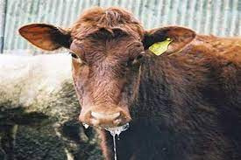



DISEASE REPORTING
Mahmud Saulawa

Slide 2
DISEASE REPORTING
Refers to the process of collecting, documenting and communicating information about the occurrence, distribution and impact of animal diseases to the relevant authorities and stakeholders.
Types of Disease Reporting
Immediate (Urgent): for outbreaks of highly contagious or zoonotic diseases i.e FMD, HPAI, Rabies.
Routine (Periodic): regular submission of data on endemic or common diseases (weekly, monthly, quarterly or annually).
Zero: reporting “no cases” when a disease is under surveillance, to confirm its absence.

Slide 3



IMPORTANCE OF DISEASE REPORTING
Reporting disease outbreaks is important, because:
  International obligation – OIE, WHO,AU IBAR, FAO.
  It identifies and controls disease outbreaks.
  Professional ethics and conduct – VCN oath.
  Support evidence-based planning and decision-making.
  Allows the detection of new microbial agents, variants, or strains in the course of work.
  Improving knowledge management (Academic researches).

Slide 4

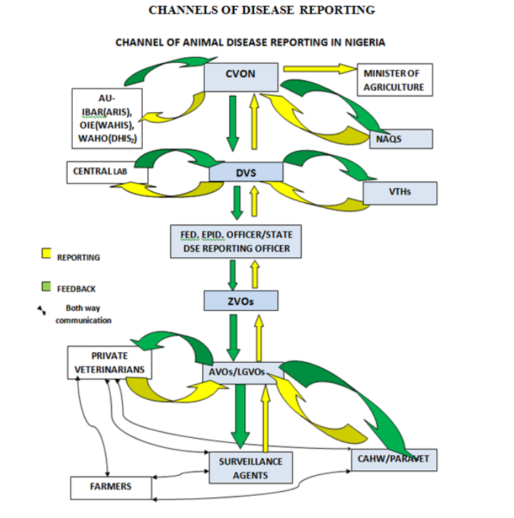
CHANNELS OF DISEASE REPORTING

Slide 5






CHALLENGES IN DISEASE REPORTING
Unrepresentative data being collected
Fragmented data (fraction per month from States)
Old and new cases reporting
Unrealistic figures
Unfilled fields/spaces

Slide 6

OTHER CHALLENGES
Lack of team work between the Federal Epidemiology Officer and the State counterpart.
Timeliness of reporting.
  Shortage of qualified and trained personnel in the field to feedback.
  Lack of communication facilities.
  Poor diagnostic facilities.
  Inadequate awareness and stakeholder participation.

Slide 7
ANIMAL HEALTH INFORMATION SYSTEM
Is a system for the collection, analysis, and reporting of information related to animal health.
Some components used in gathering such data include;
  Routine diagnostic data
  Slaughterhouse records
  Herd monitoring systems
  Livestock population census
  Disease control program and implementation records

Slide 8
IMPORTANCE OF ANIMAL HEALTH INFORMATION SYSTEM
Such system provides the Veterinary Services:
  With timely, reliable and complete information for immediate action and future planning.
  Data on performance indicator for self-evaluation.
  Data for regional, continental and international reporting.

Slide 9
IMPORTANCE OF ANIMAL HEALTH INFORMATION SYSTEM
  Organizes disease surveillance and reporting network.
  Laboratory networking.
  Collation, analysis and reporting of Animal Health situation of the country
  Liase with OIE, AU-IBAR and other external bodies
  Conduct Risk Analysis

Slide 10
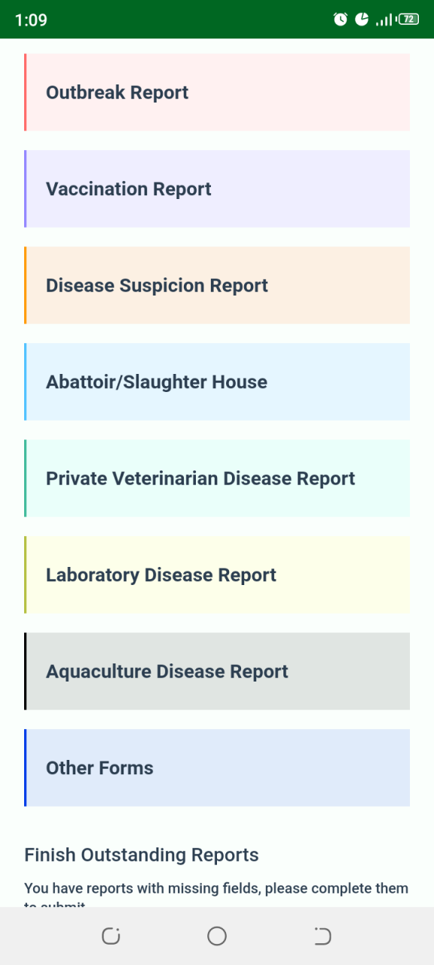
INTRODUCTION TO NADIS
National Animal Disease Information System
Nigerian system for tracking animal health-Zoonotic diseases and other disease outbreaks in livestock and other animals.
Objectives includes;
For faster detection and reporting of outbreak.
More accurate and timely data from field for faster analysis.
Expanding surveillance points, so as fewer outbreaks are missed.

Slide 11
WAHIS
  Managed by The World Organization for Animal Health (WOAH)
  Global online platform used by member countries (Nigeria included) to report animal diseases in real-time.
  Key functions includes:
  Disease Reporting: outbreaks of TADs, Zoonotic and Emerging diseases.
  Transparency & Early Warning: real-time alerts about outbreaks globally.
  Data Sharing; on zoonotic potentials, control measures taken, outbreak locations.
  Compliance with International Standards: reporting through WAHIS is an obligation for all WOAH member states under International Health Regulations (IHR).

Slide 12
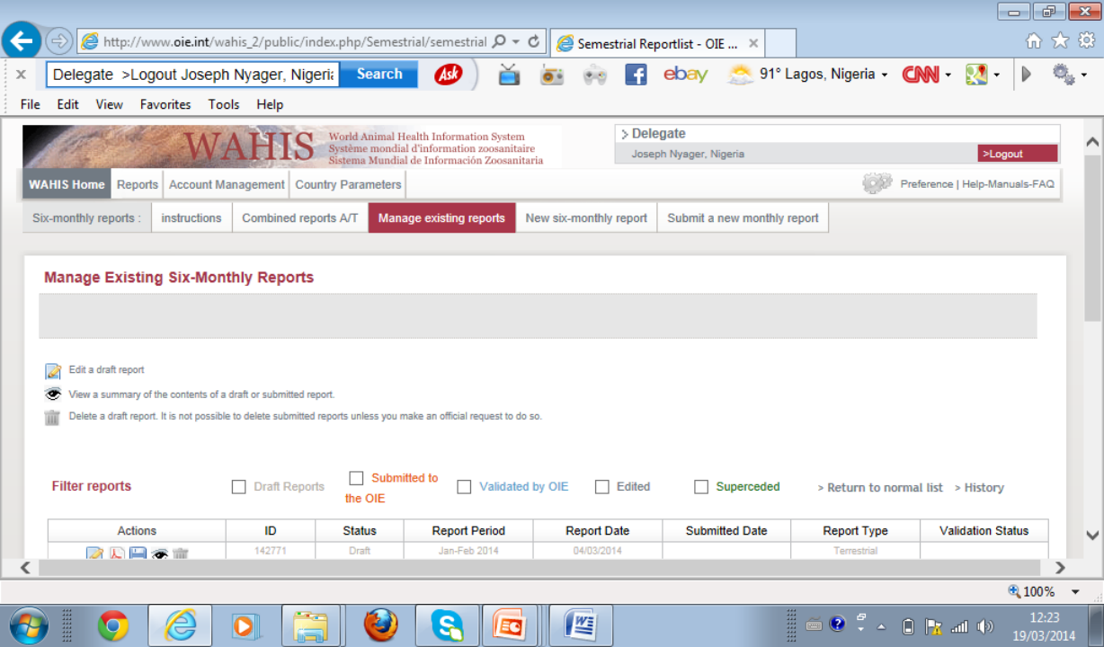

Slide 13
Nigerian Human Health Information System
Main platform for collecting, analyzing and reporting health data across Nigeria.
Covers Primary, Secondary and Tertiary health facilities.
Collects data on; Outpatient visits, Maternal and child health, Immunization, Disease surveillance, Mortality and morbidity statistics.
Uses DHIS2 (District Health Information System 2) as the digital platform.
IDSR (Integrated Disease Surveillance & Response); focuses on early detection and reporting of epidemic-prone diseases i.e Cholera, Measles
SORMAS (Surveillance Outbreak Response Management & Analysis System): Used by NCDC for real-time outbreak reporting and case management.

Slide 14


